Slide 1
Networking
A Sharpe Curriculum

Slide 2
Biggest change net-tools
Linux commands the majority of users are familiar with are:
ifconfig - see layer 2 and 3 (mac address and IP)
route - route table
arp - arp table (known MAC/IP address mapping)

Slide 3
Biggest change net-tools
netstat is a very popular tool for displaying connection information which has been replaced by ss

Slide 4
net-tools has been deprecated
If you just cannot do without those commands they can still be installed by running apt install net-tools
But it’s suggested that instead you become familiar with iproute 2

Slide 5
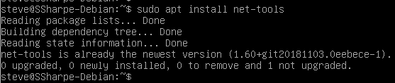

Check if you have net-tools
Appears we have net-tools
But, but it doesn’t run?

Slide 6


Where is the file then?
Using whereis locate ifconfig

Slide 7

Test that it runs
Using the absolute path test that you can run ifconfig.
Why did we need the absolute path?

Slide 8
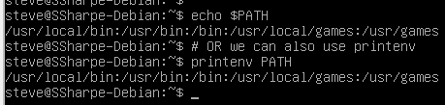
PATH
The directory /usr/sbin is not in our path
On most distributions regular users have this in the path, but only root has it in Debian. We disabled root in our previous lab.

Slide 9
Filesystem Hierarchy Standard
Rather than overload, we’ll gradually introduce Filesystem Hierarchy Standard (FHS) directories. It’s a reference that most distributions follow for the filesystem layout in UNIX, which in our case would be flavours of Linux. Today we’ll introduce common binary locations.

Slide 10
Filesystem Hierarchy Standard
/bin : For binaries usable before the /usr partition is mounted. This is used for trivial binaries used in the very early boot stage or ones that you need to have available in booting single-user mode. Think of binaries like cat, ls, etc. Discussion: does this apply today? Source: Wikipedia

Slide 11
Filesystem Hierarchy Standard
/sbin: Same, but for binaries with superuser (root) privileges required.
/usr/bin: Same as first, but for general system-wide binaries.
/usr/sbin: Same as above, but for binaries with superuser (root) privileges required. Source: Wikipedia

Slide 12
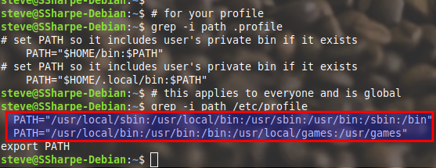
Understanding paths
Top part is a profile for a single user. Bottom is for all users.
Highlighted portion: How does this work with two paths??

Slide 13
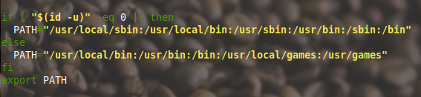
Understanding paths
There is actually only a single path. The logic reads: If your id is 0 run the first path. Anyone else run the second path. Which one has /usr/sbin. Who do you think has id of 0?

Slide 14

Challenge
Modify the if statement to include your account that is your FirstName AND root.
Bash if statements guide
When you login you should have access to /usr/sbin in YOUR profile. Remember to logout and login for this new path to apply.

Slide 15
Why iproute2?
While net-tools serves simple tasks such as displaying information and simple tasks such as setting IP addresses it doesn’t support any advanced features.

Slide 16
Why iproute2?
The network subsystems in Linux have been completely redesigned since version 2.2 and those features are unavailable in net-tools.
These features were not needed in an era of net-tools such as: new routing features, filtering, classifying, and traffic shaping.

Slide 17
Why iproute2?
Wait? The kernel was redesigned, but net-tools still works. How?
When you ask for an ip address, set an ip address or any interaction with those utilities actually use the iproute2 syscalls. It’s really just a UI for legacy purposes now.

Slide 18
These features sound like what we’re learning Cisco..
Linux has very little competition in the general OS arena for networking and as the original documentation says the features rival many dedicated routers, firewalls and traffic shaping products.

Slide 19
All the acronyms
Terms you’ll hear in your Cisco courses are fully supported natively by Linux
OSPF for internal routing
BGP for Internet routing (between Service Providers)
QoS - traffic shaping

Slide 20
All the acronyms
Terms you’ll hear in your Cisco courses are fully supported natively by Linux
Port bonding/NIC teaming/EtherChannel
STP - prevents switching loops see Cumulus Networks
VPN - virtual private network
Way, way more..

Slide 21
Real time changes vs persistant
We can set an ip address using net-tools & iproute2 however unless we set these settings in a configuration file they’ll be gone on subsequent reboots.
Spend some time following this guide

Slide 22
Lab
Make a change to the sudoers
Net-tools - use net-tools to explore your network in bridged mode
iproute2 - use iproute2 to explore your network in NAT mode

Slide 23
Strange naming conventions
Back in the day network adapters used to have simple names like eth0, eth1, what happened??

Slide 24
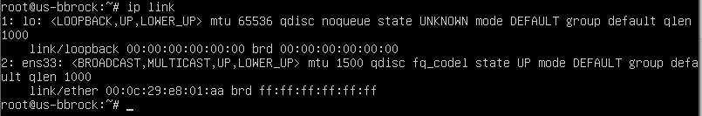
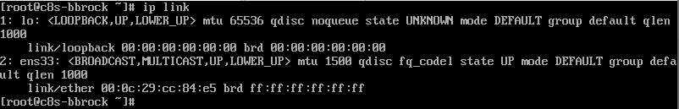
Interface Names
There are old and new ways to name interfaces as well, along with distribution differences.
Old versions are eth0, eth1, new versions may have enso1, or wps04, or a number of other options.
To get the current available network interfaces on ALL Linux distributions, you can run the command ip link.
On Ubuntu
On CentOS
Credit Brian Brock

Slide 25
Interface Names
The “new” Linux naming system for network cards will name them based on what type of card, where it is installed, and what hardware interrupt it listens on…
For VMWare, we have virtual hardware, so you will see that the first VMWare network port is usually ens33 (Ethernet card in physical slot 3, listening on interrupt 3).
Credit Brian Brock

